Slide 1
Architecture #1
* Adding the keywords in the beginning of the tweet text under the assumption that keywords are significant while appearing and so we want double the impact of the keywords

Slide 2
Adding keywords as strings at the beginning of the text
Split to train test set
Clean the text (looking for URLs, digits, dates, etc.)
Keywords
Embedding layer (size 100)
Clean the text (looking for URLs, digits, dates, etc.)
Clean the text (looking for URLs, digits, dates, etc.)
Network
Bidirectional LSTM layer
Dense (size 256)
Lemmatization of the text
Tokenization + padding (max len =200)
Pick recall == 0.8
Dense (size 1)
Split to train test set
Build embedding matrix base on glove corpus

Slide 3
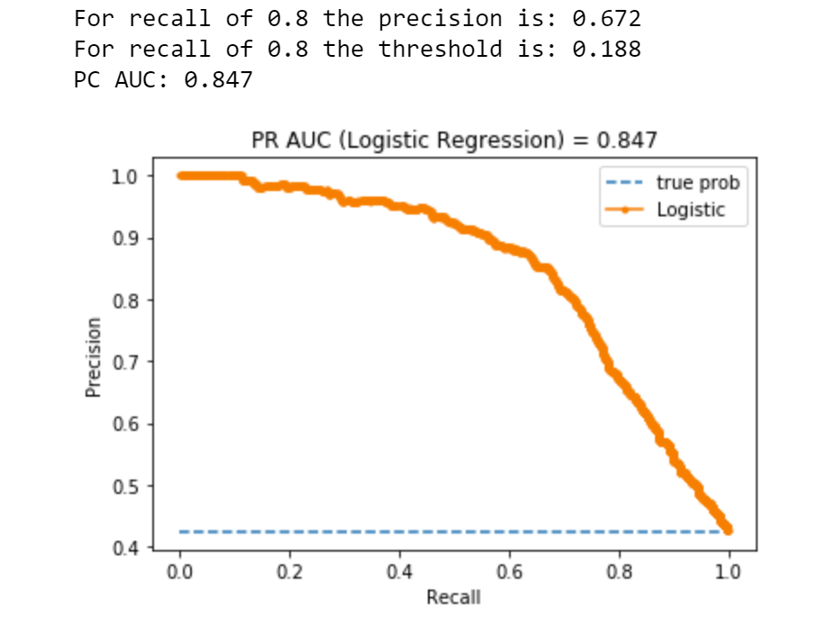

Slide 4
Architecture #2
* Concatenate the meta features to the lstm layer as add on features

Slide 5
Adding keywords as strings at the beginning of the text
Split to train test set
Clean the text (looking for URLs, digits, dates, etc.)
Embedding layer (size 100)
Bidirectional LSTM layer
Clean the text (looking for URLs, digits, dates, etc.)
Clean the text (looking for URLs, digits, dates, etc.)
Network
Meta features
Dense (size 128)
Dense (size 128)
Lemmatization of the text
Tokenization + padding (max len =200)
Pick recall == 0.8
Dense (size 1)
Split to train test set
Build embedding matrix base on glove corpus

Slide 6
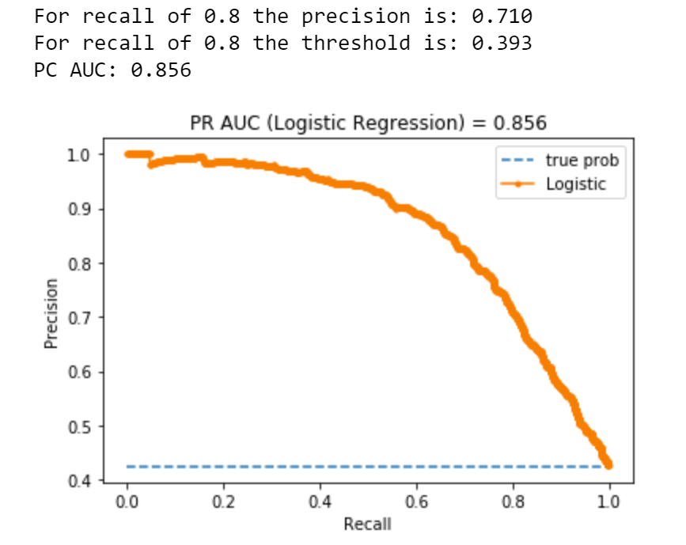

Slide 7
Architecture #3
* Conve 5 filters (intuition – 5th gram) and pool max - in order to take the most significant of it

Slide 8
Adding keywords as strings at the beginning of the text
Split to train test set
Clean the text (looking for URLs, digits, dates, etc.)
Embedding layer (size 100)
Conv 1D (5 filters)
Clean the text (looking for URLs, digits, dates, etc.)
Clean the text (looking for URLs, digits, dates, etc.)
Network
maxpool
Bidirectional LSTM layer
Lemmatization of the text
Tokenization + padding (max len =200)
Pick recall == 0.8
Dense (size 128)
Split to train test set
Build embedding matrix base on glove corpus
Dense (size 1)

Slide 9
